Slide 1
Controlled Electromagnetic Levitation in Multiple Dimensions
Group WR1
28/11/2018

Slide 2
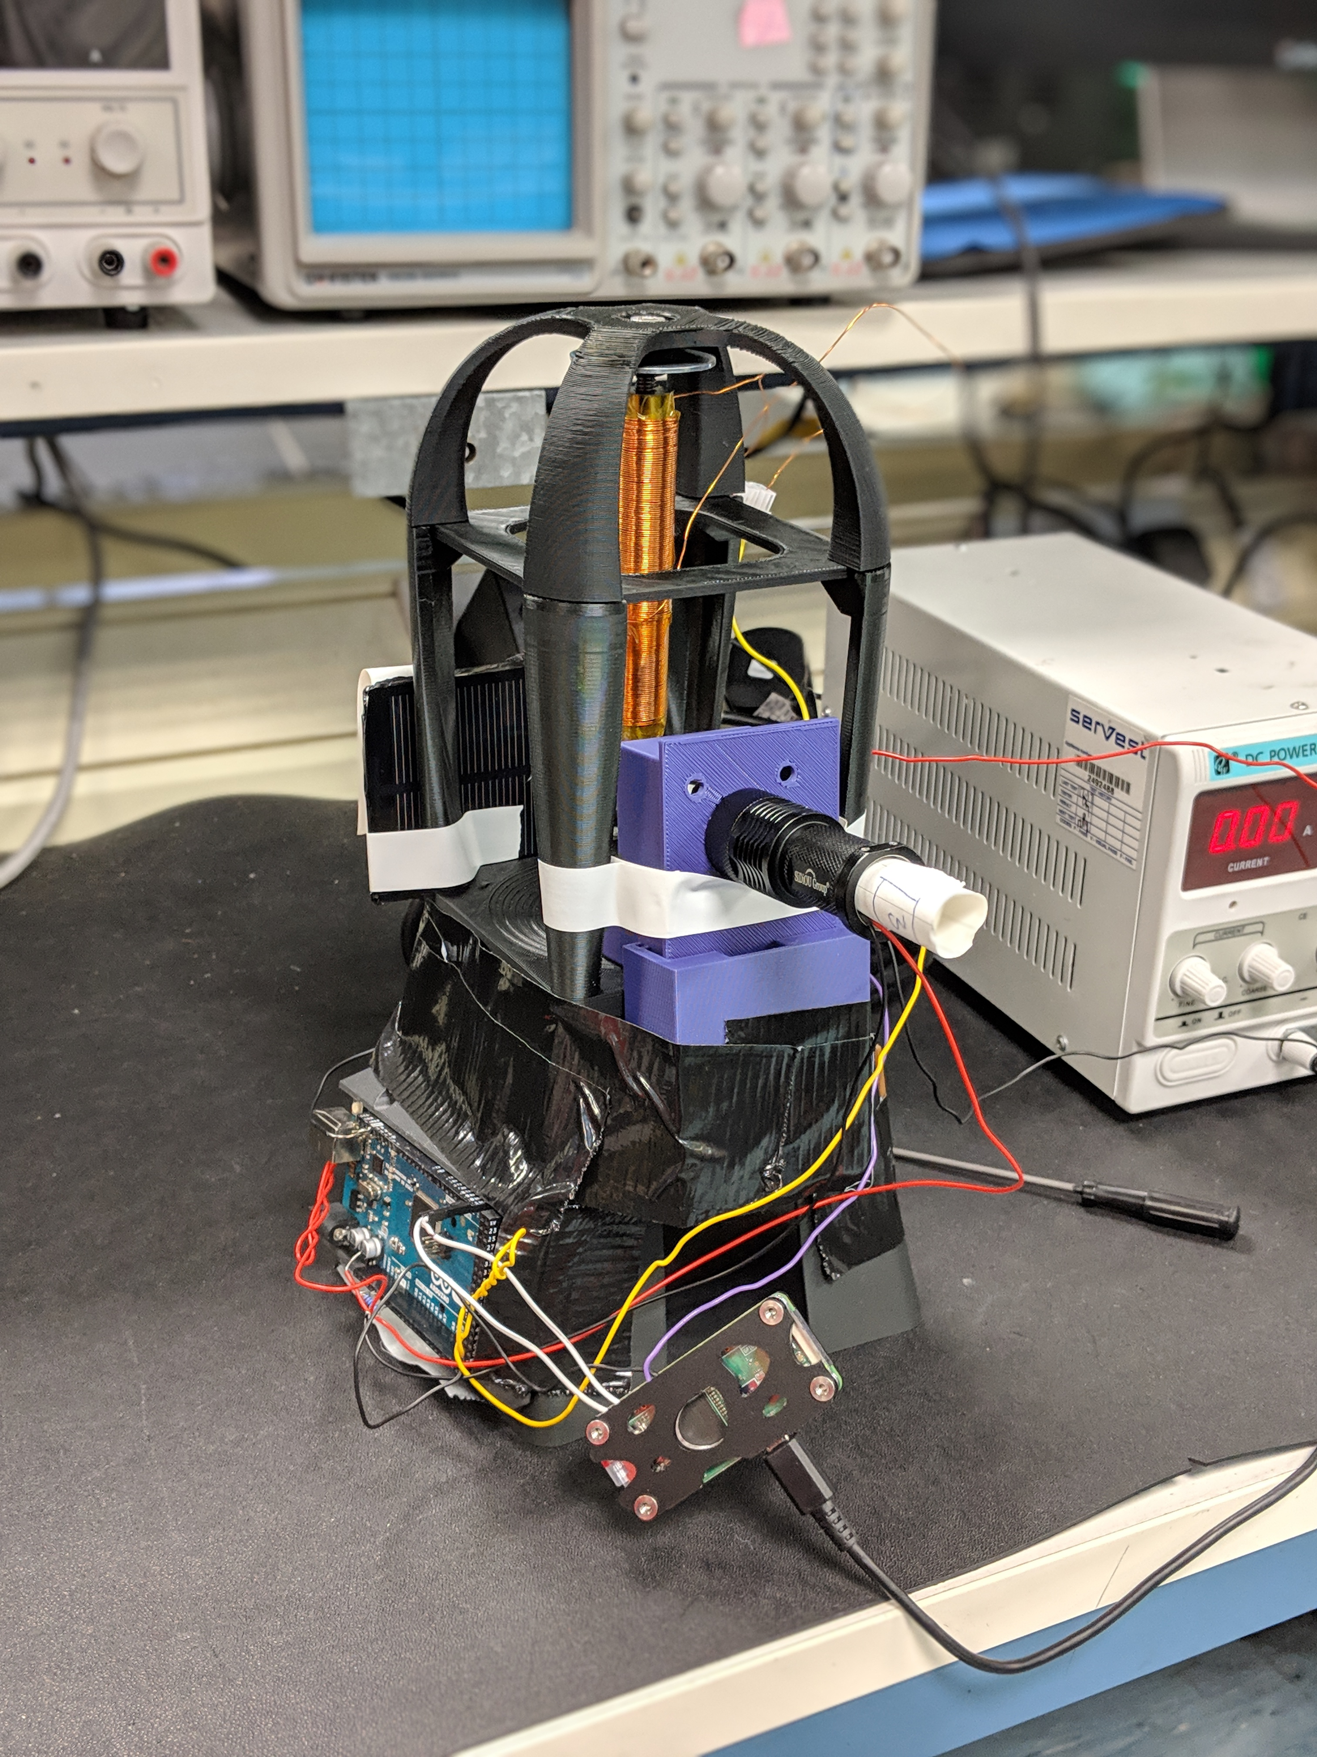
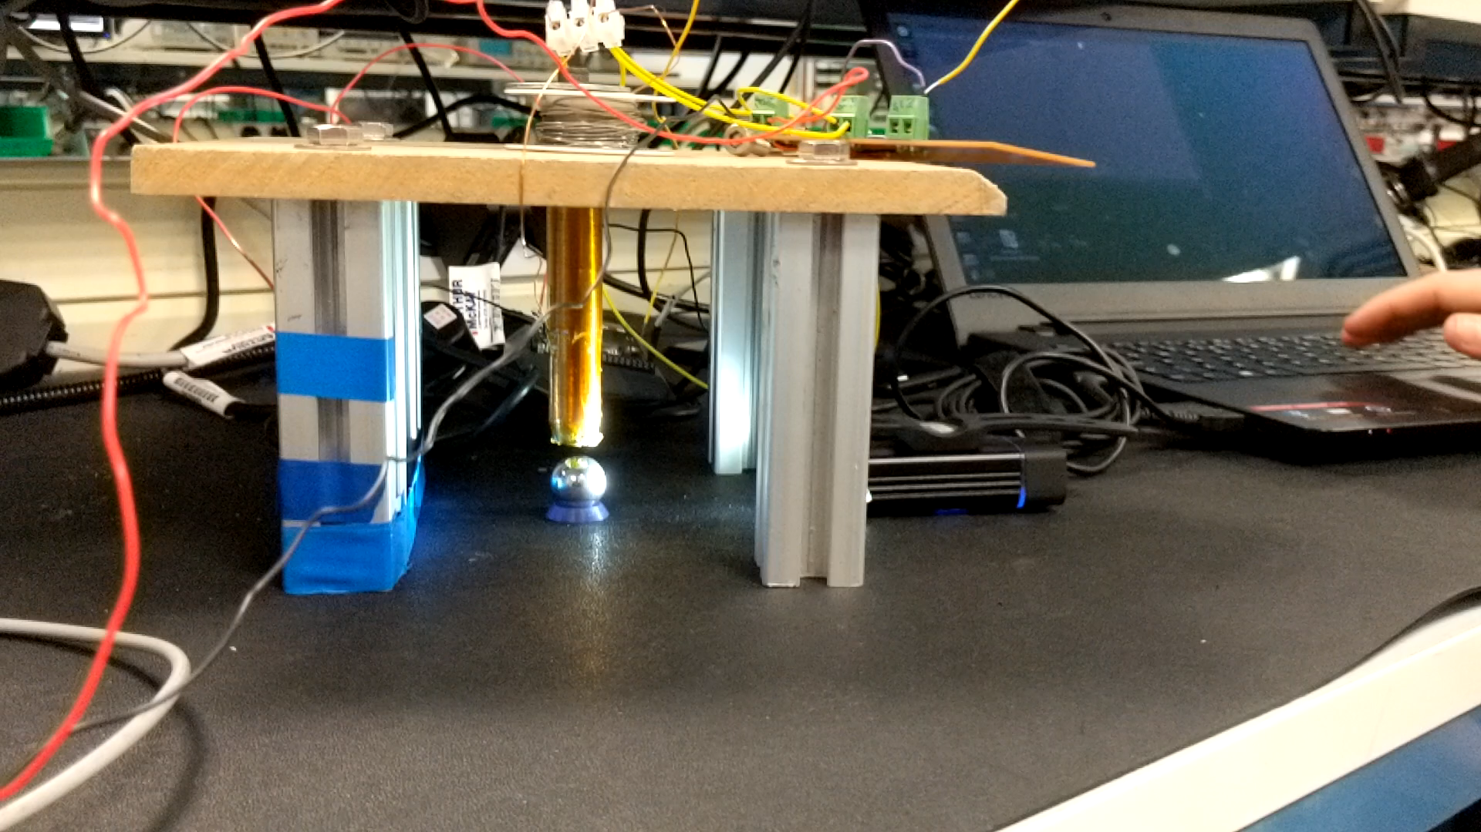
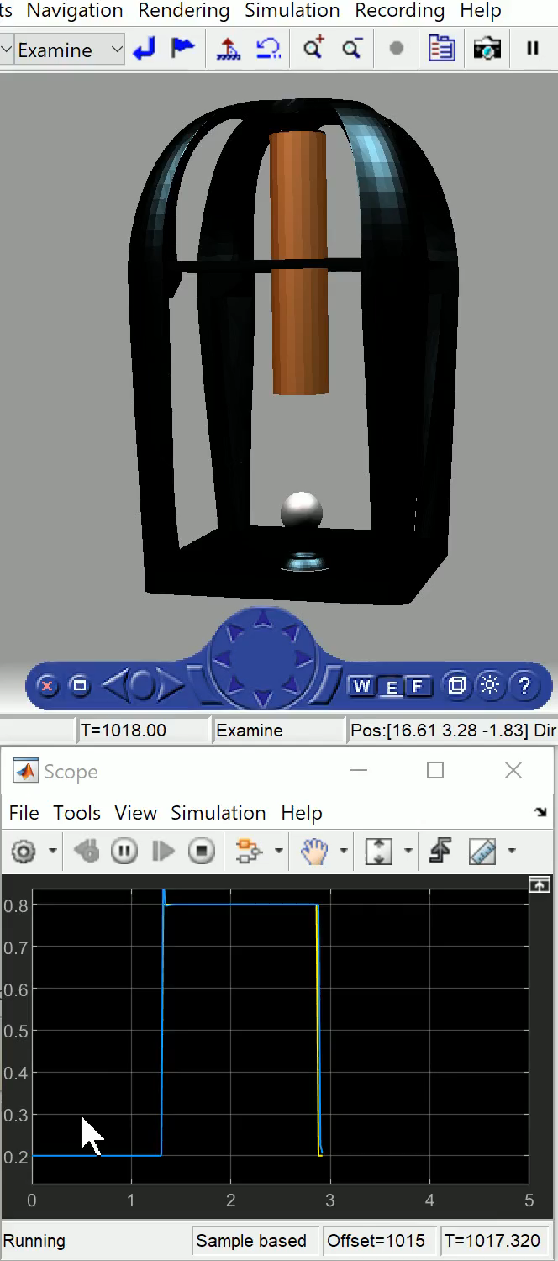
Recap from last time…
Multi-dimensional levitation of a steel ball with electromagnets and control theory
Simulation
1D – first half
Achieved a model that achieved stability for vertical control
2D – second half
Horizontal and vertical control
Experimentation – 1D vertical control around one point
First half
Exploring sensor options
Built a rig
Second half
Improving the rig
Further exploring sensor options
Making it work!
Notes:
We set ourselves the ambitious goal of achieving levitation in multiple dimensions using an array of electromagnets
It is a very challenging problem and hasn't been achieved properly before (as far as we are aware)
There are several interesting applications for this technology such as use of magnetic bearings in flywheel energy storage systems, since magnetic bearings can be used in a vacuum, unlike mechanical bearings (due to lubricant)

Slide 3
Project Goals (second half)
1D Physical System
Limitations of the current design and methods
Re-evaluate options
Stable levitation of a steel ball
Analyse results and further improvement
2D Simulation
Build a realistic system model to find transfer functions
Develop a control strategy for robust horizontal and vertical levitation
Notes:
The second half of the project was even more challenging than the first half, and we knew this would be the case.
However, we decided to continue with our original goals of achieving 1D physical levitation and modelling 2D levitation.
1D:
Analyse the limitations of the current design and methods and re-evaluate our options
Achieve stable levitation of a steel ball
Analyse our results and provide ways in which we could further improve the results and allow others to continue where we left off
2D:
Develop a model for horizontal and vertical levitation (combined)
(Did we simulate this graphically?)

Slide 4
Allocated Tasks (second half)
Max Benson - Project management and code design
Yidan Xue - 2D physical model and derivation of transfer functions ​
Maurice Rahme – MIMO system description and control system design
Daniel Carbonell – Design, manufacturing and testing of physical system and experimental rig​
Emil Hansen – Electronics and code design
Notes:
The roles for the second half were split between working on the 1D physical system, (Dan, Emil and me) and the 2D model, with Yidan and Maurice working on this part.

Slide 5
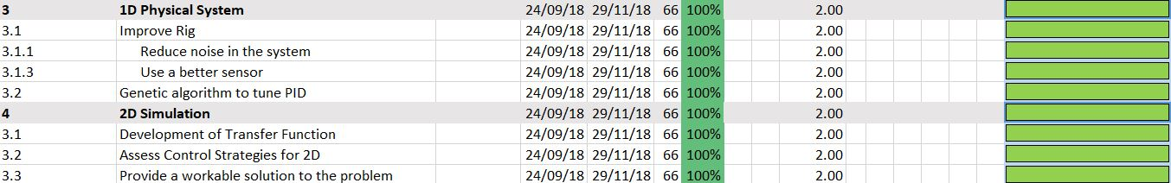
Project Plan (second half)
Notes:
Here is a condensed project plan for the second half of the project

Slide 6
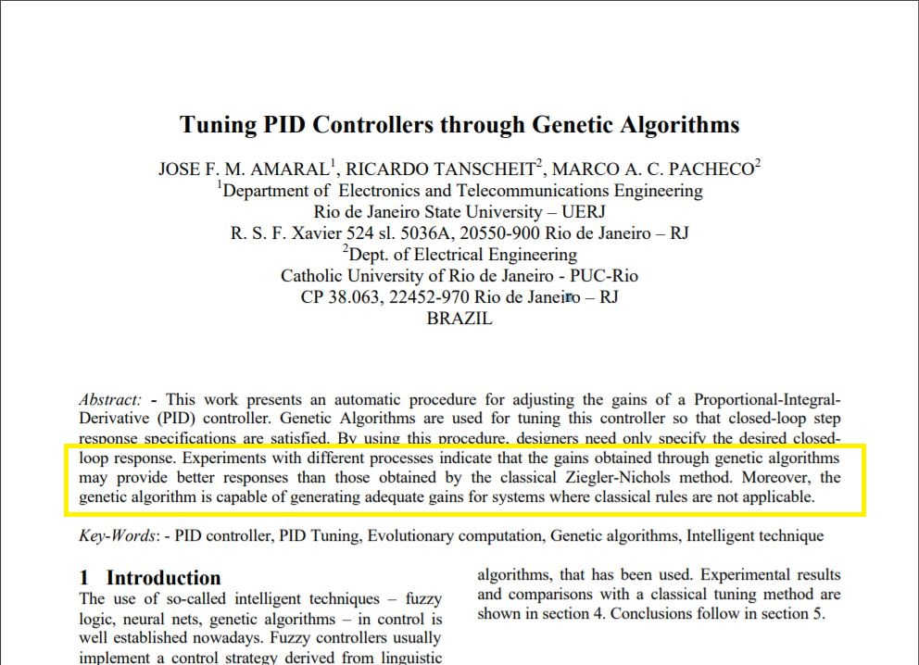
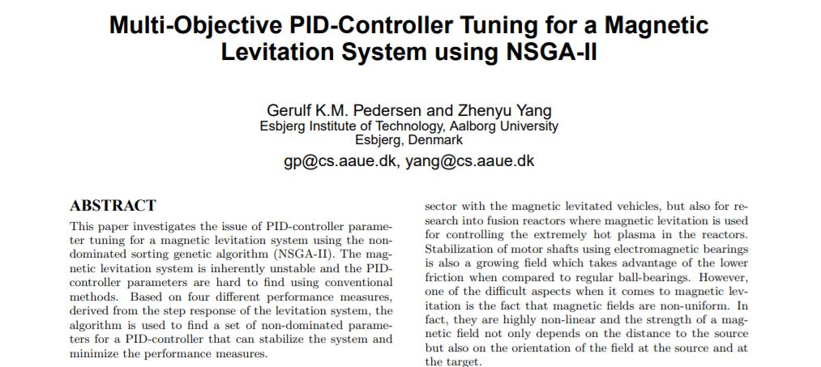
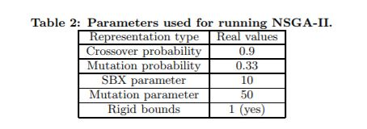
Genetic Algorithm (GA)
Had difficulty tuning the physical system by hand
Tried Ziegler-Nichols and intuitive tuning without success
Designed a genetic algorithm for automatically tuning the physical system
Notes:
Despite many attempts, using Ziegler-Nichols and using our intuition, we had difficulty tuning the PID control system by hand.
This is because of complications such as noise in our sensor and actuator, because our system is non-linear and because we couldn’t get the system to move at a consistent oscillation frequency.
Therefore, we decided to attempt to automatically tune the controller, with a genetic algorithm being one of the best methods proposed (cite paper on GA > Z-N)

Slide 7
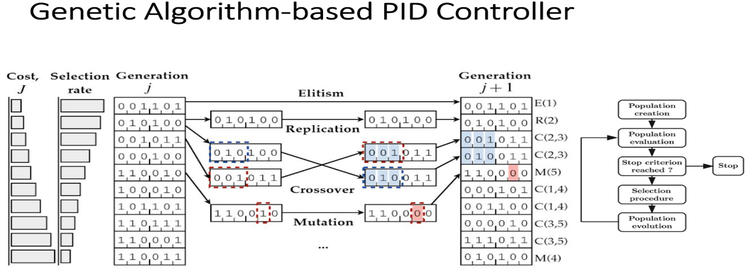
Genetic Algorithm (GA)
Notes:
The genetic algorithm is based on Darwinism and Herbert Spencer's concept of "survival of the fittest", and works in our system as follows:
A set of 50 chromosomes are randomly allocated PID coefficients and are tested on our system, by means of a fitness function – reference - http://citeseerx.ist.psu.edu/viewdoc/download?doi=10.1.1.421.36&rep=rep1&type=pdf
This was defined as the inverse of the system error, meaning that a higher fitness equates to a better system
The next population is determined in a few ways:
Crossover: Chromosomes are picked randomly, but with a higher probability given to the fitter chromosomes
Replication: There is a possibility that any given chromosome will be carried forward to the next population
Mutation: Each new of the newly bred chromosomes have a chance to “mutate”, where a slight change to their properties is introduced, adding the possibility of improving a population beyond its current best chromosome
Elitism: The best chromosome in a population is carried forward to the next, reducing the chance for genetic drift
This method of tuning has been shown to produce very good PID parameters (and we are confident that with good hardware, we can achieve similarly great results)

Slide 8
Sensors

Slide 9
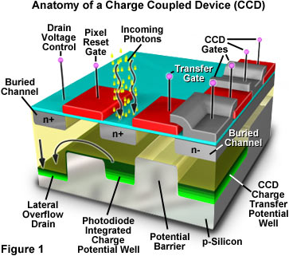
CCD
Potentially best option
Expensive
High overhead in implementation

Slide 10
Important factors for sensors
Accuracy
Precision
Noise
Read Frequency
Range of operation

Slide 11
Which sensor to choose
Analogue
Digital
Higher read frequency
Higher precision
Higher range of operation
Higher accuracy
More resistant to noise

Slide 12
Linearising analogue sensor
dV/ds not constant

Slide 13
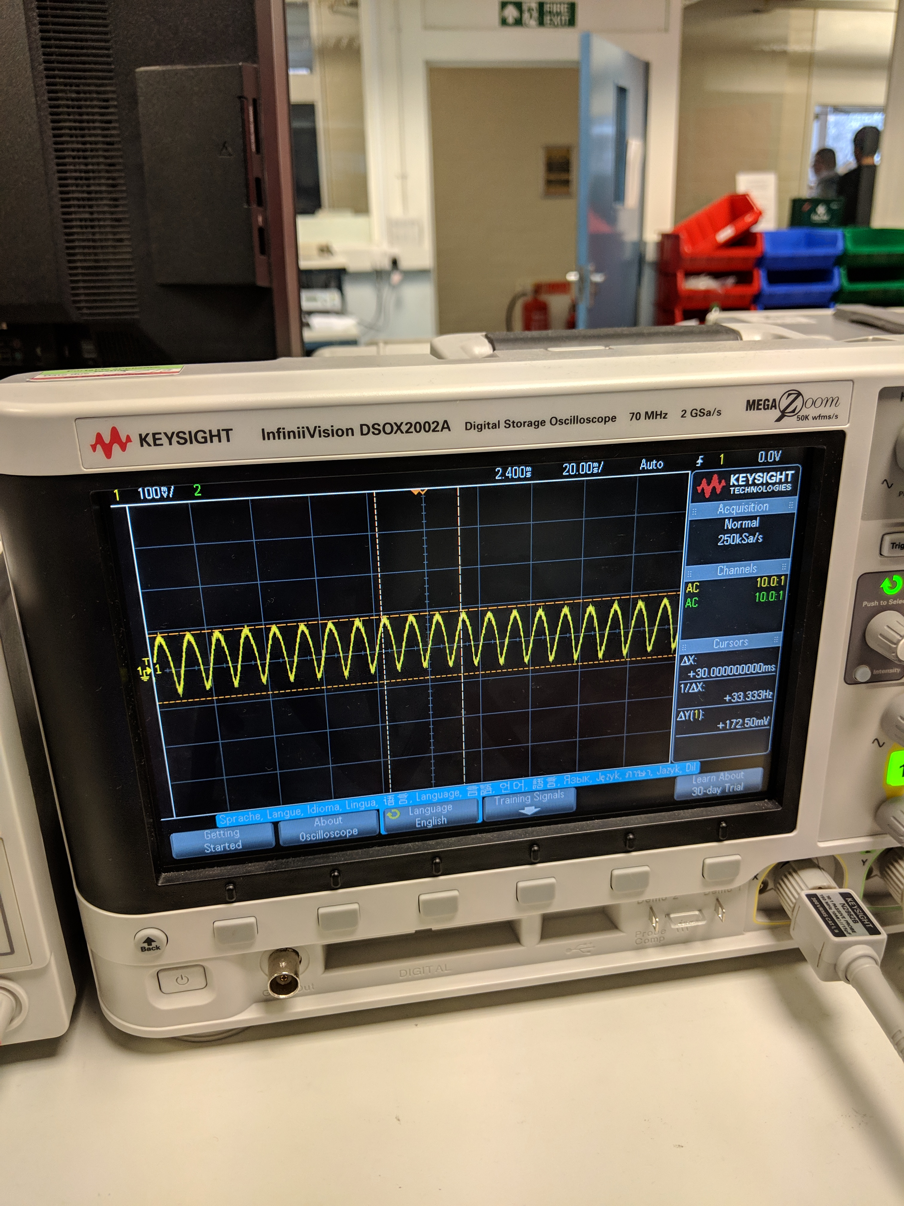
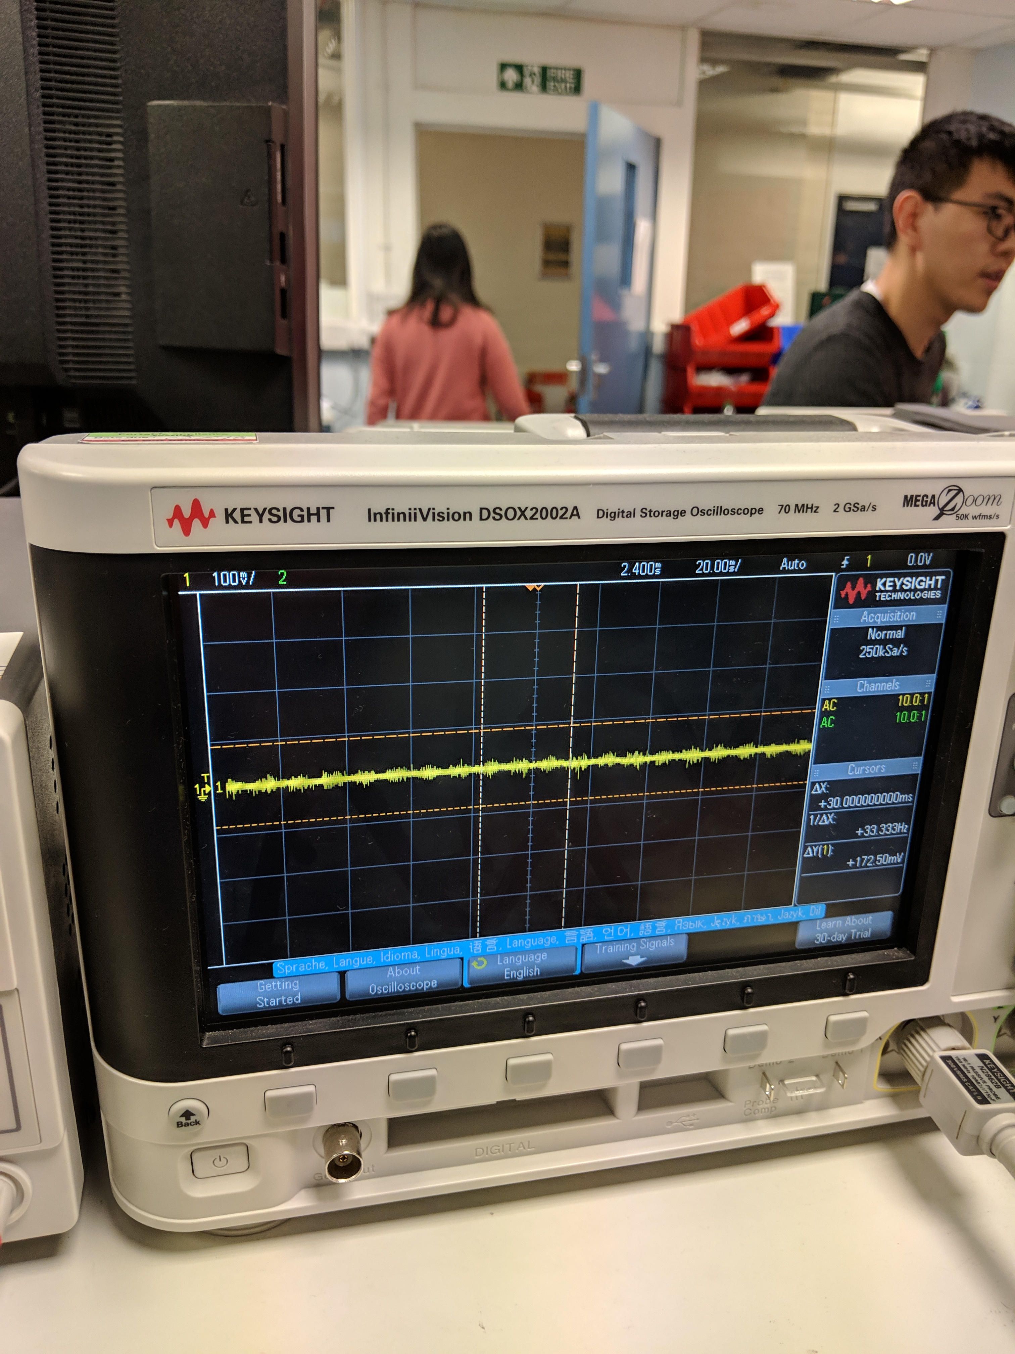
Filtering Noise
Noise on raw signal
Noise after amplification and shielding

Slide 14
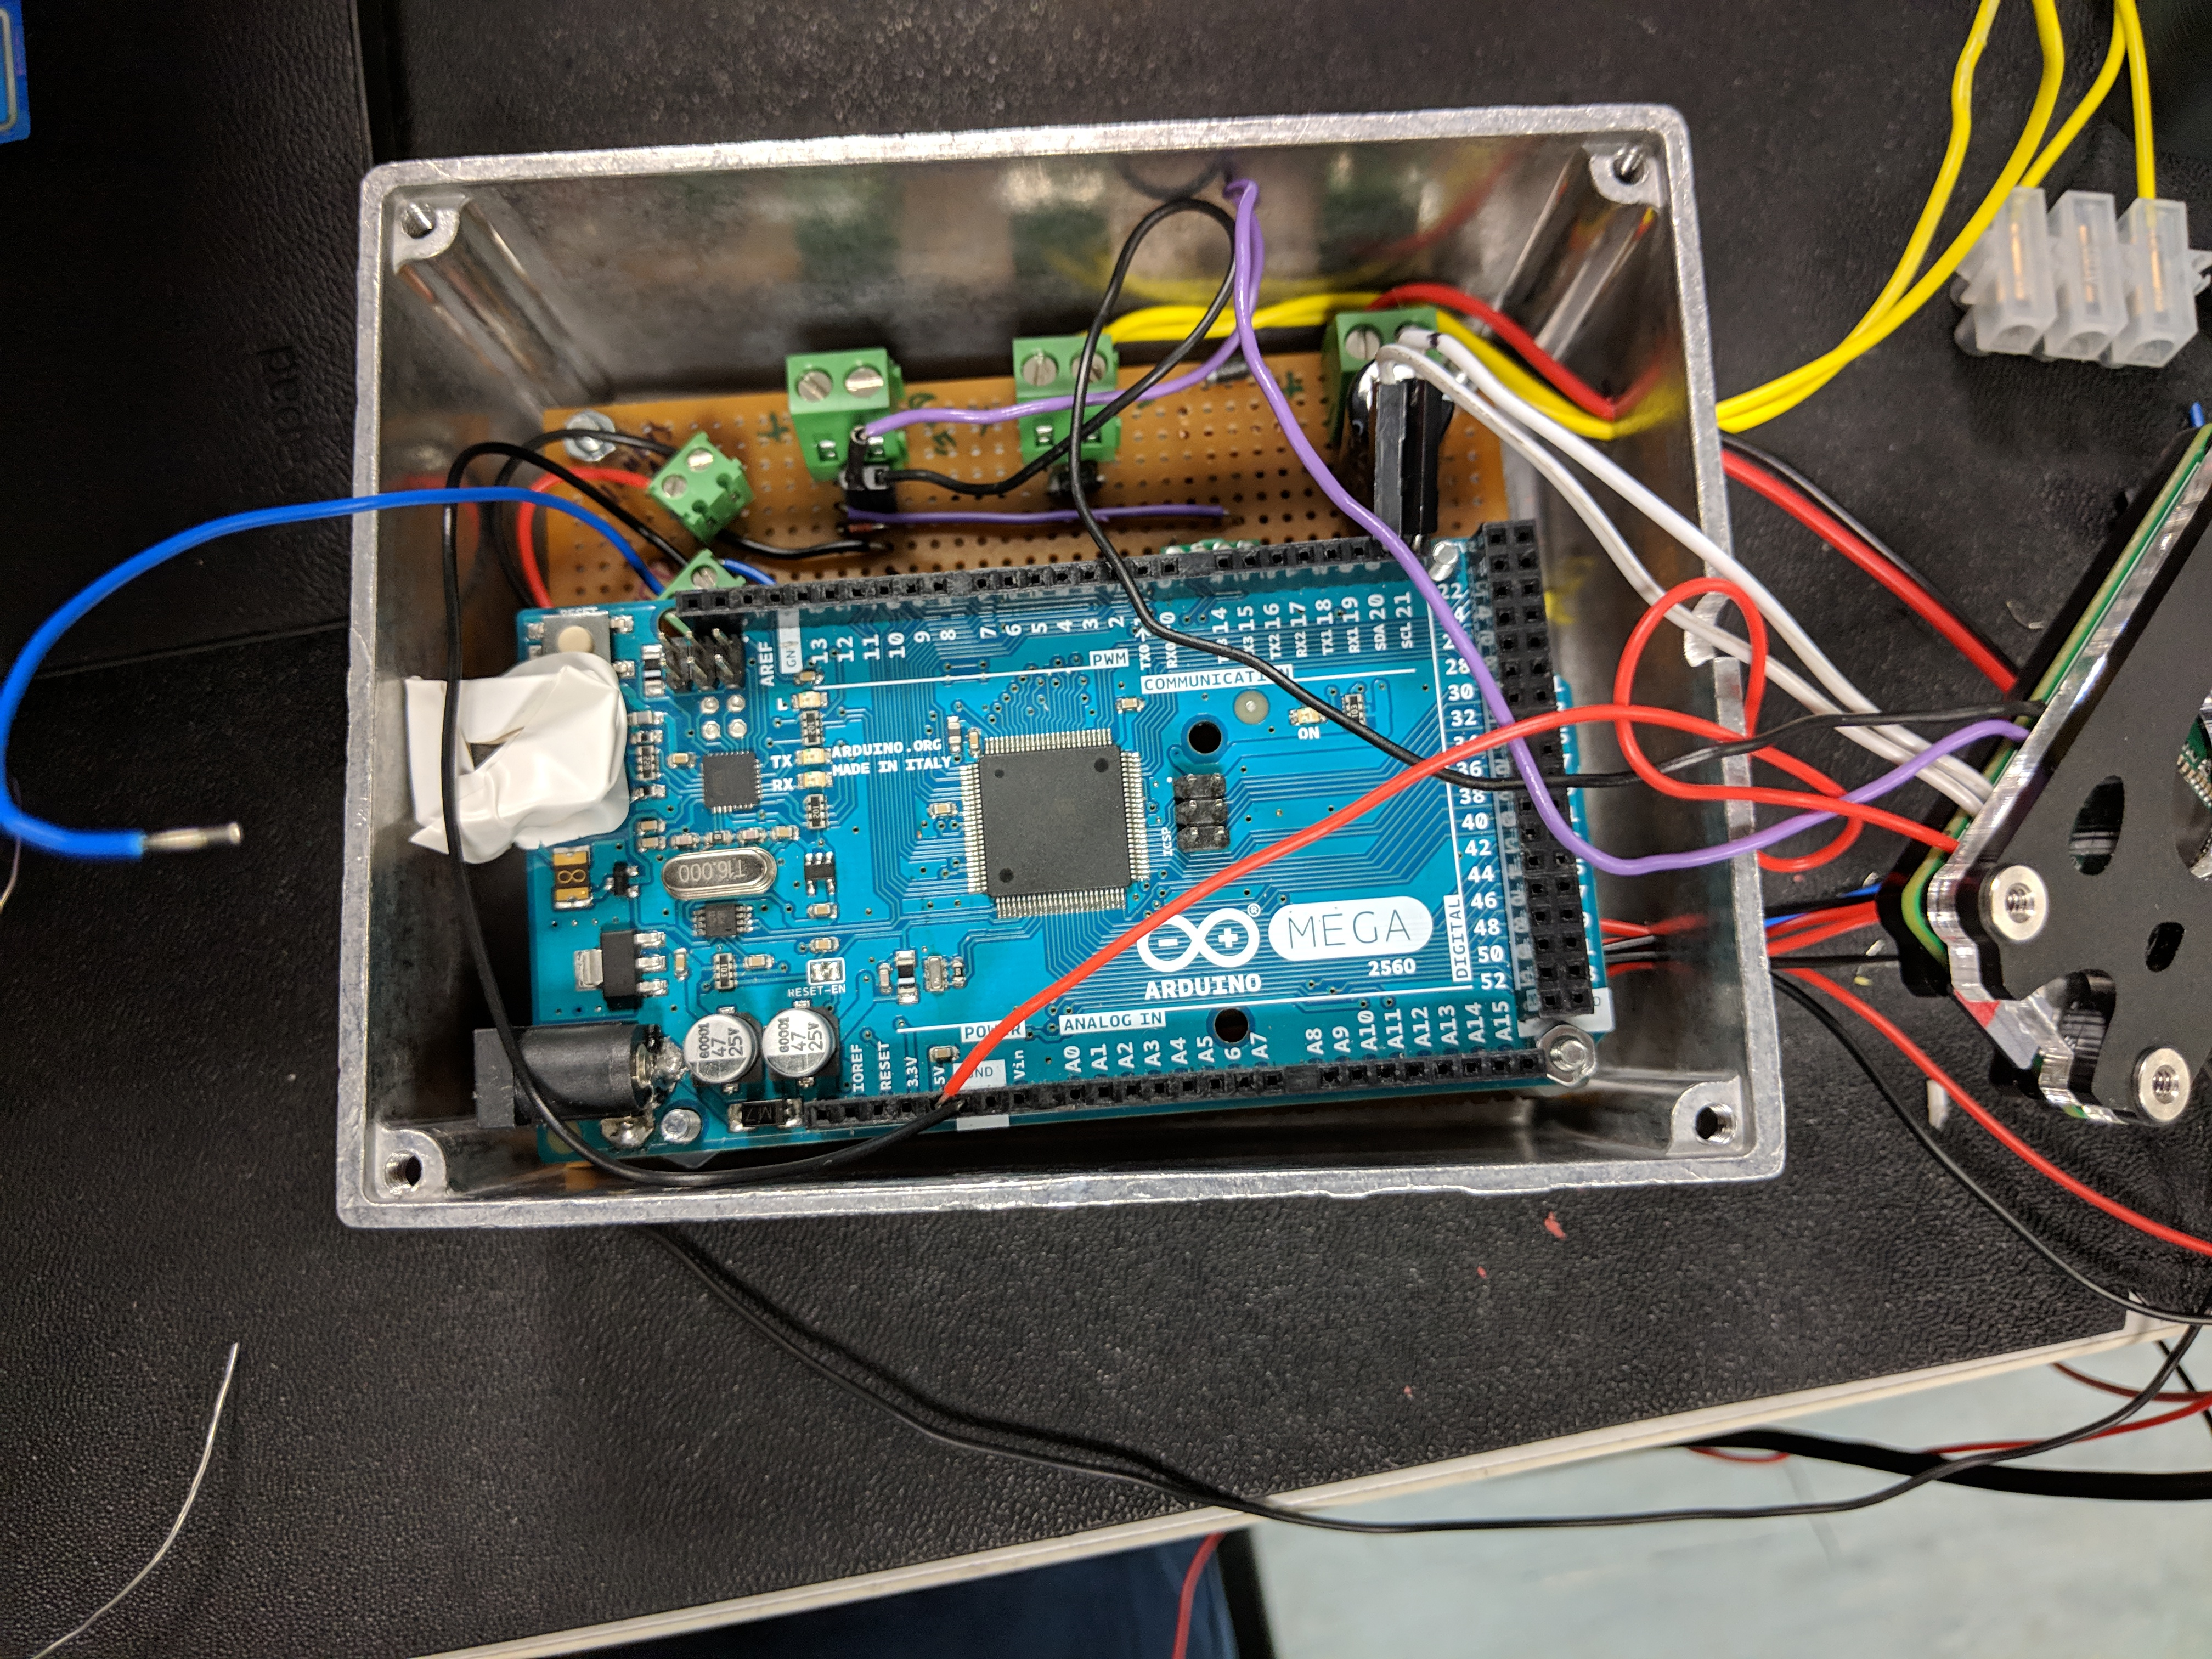
Shielding

Slide 15
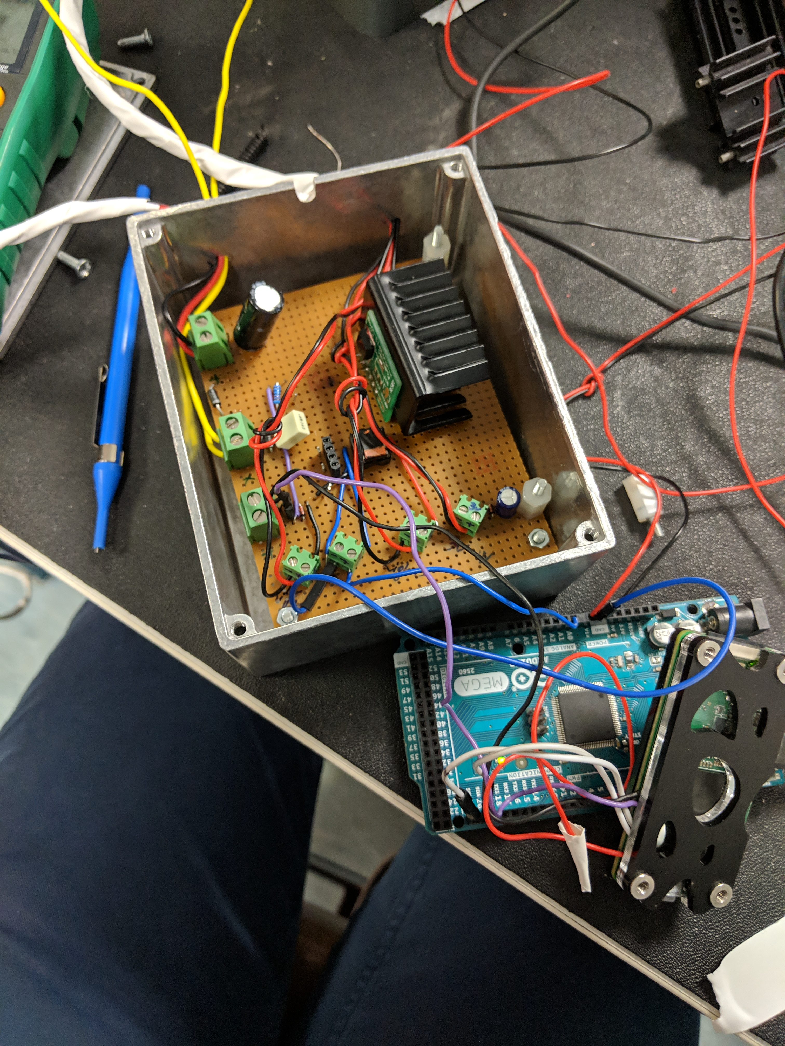
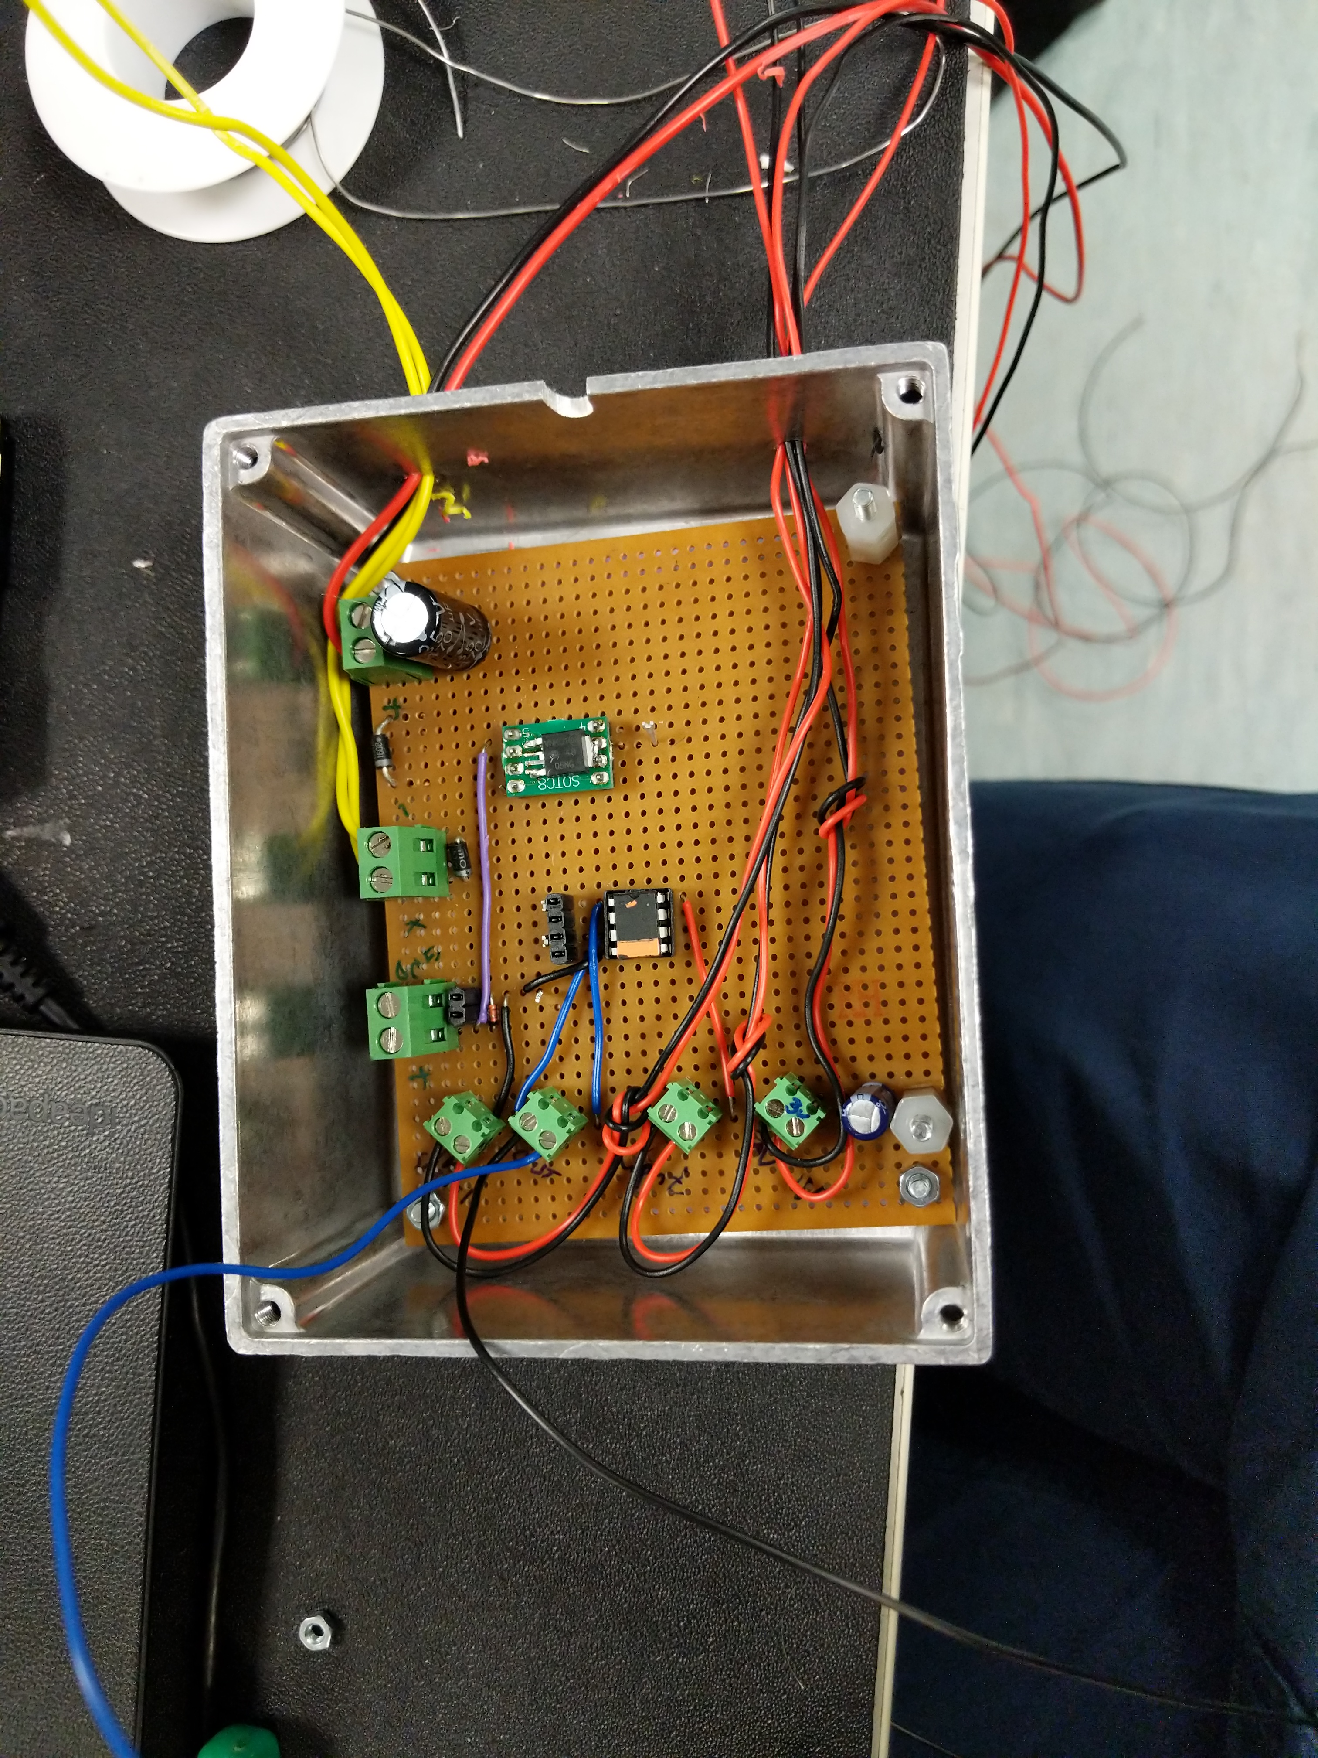
Thermal Considerations
Notes:
Coil heated up to 100degrees
Chip melted at around 120

Slide 16
Using Lasers as Sensors

Slide 17
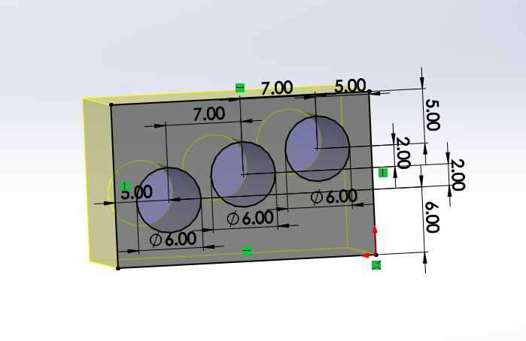
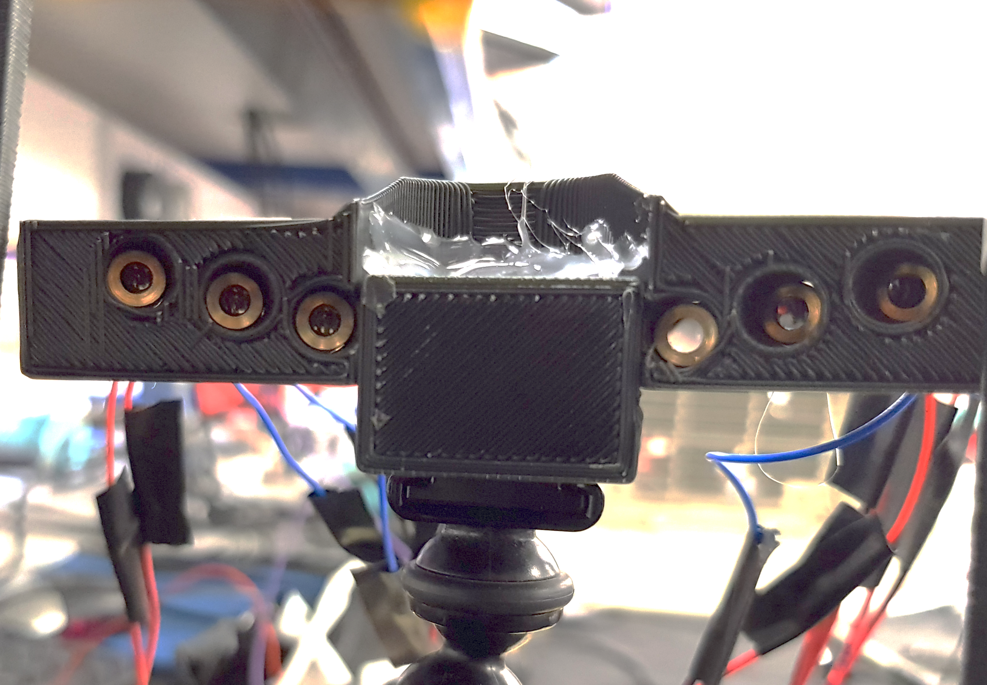
Concept
Uses two pairs of three offset lasers & photodiodes
Spacing on each pair is offset
Vertical resolution of 1mm with 6mm range

Slide 18
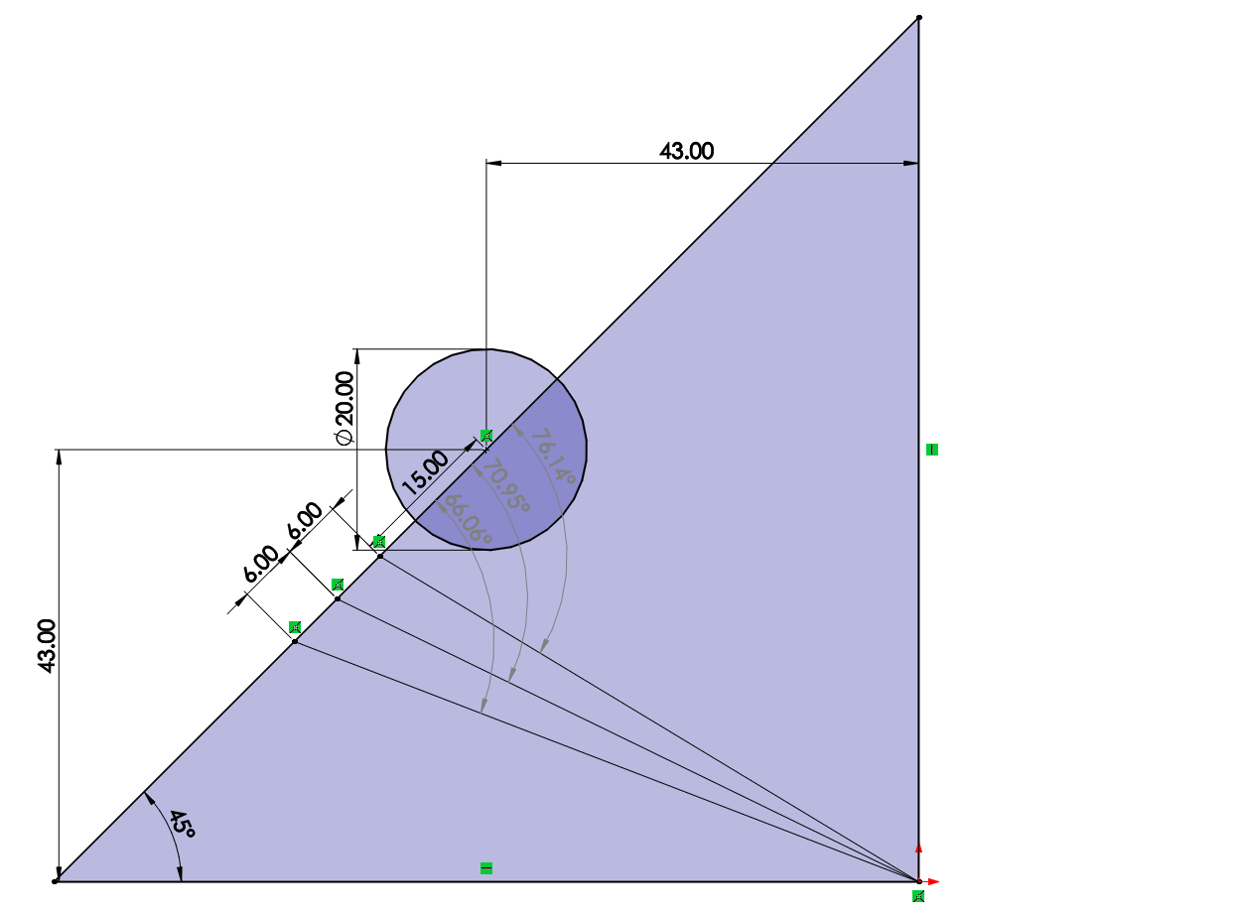
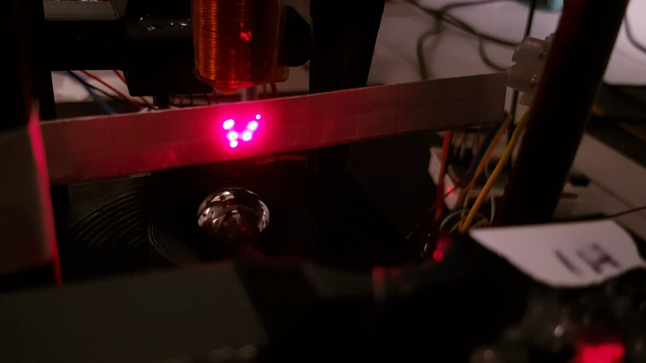
Geometry
This concept relies lasers converging
Angles were determined based on rig
Supports were made with angled slots for lasers

Slide 19
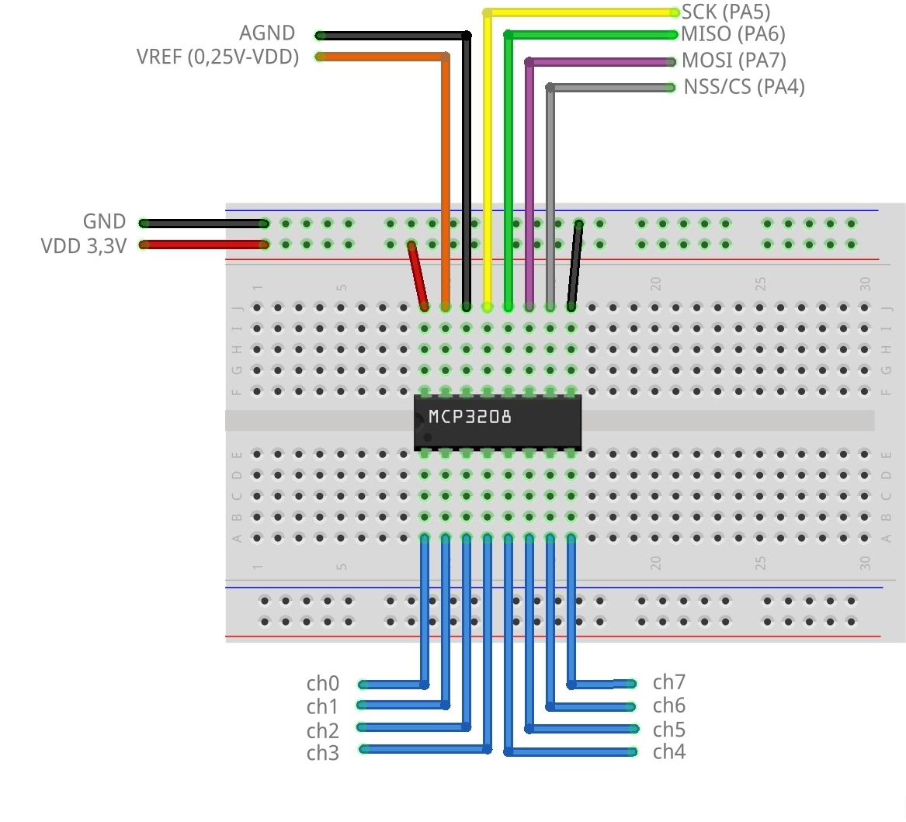
Electronics
5V reference voltage
Readings from photodiode go to an ADC
Overall response time is around 1ms
Biggest speed bottleneck is reading ADC values

Slide 20
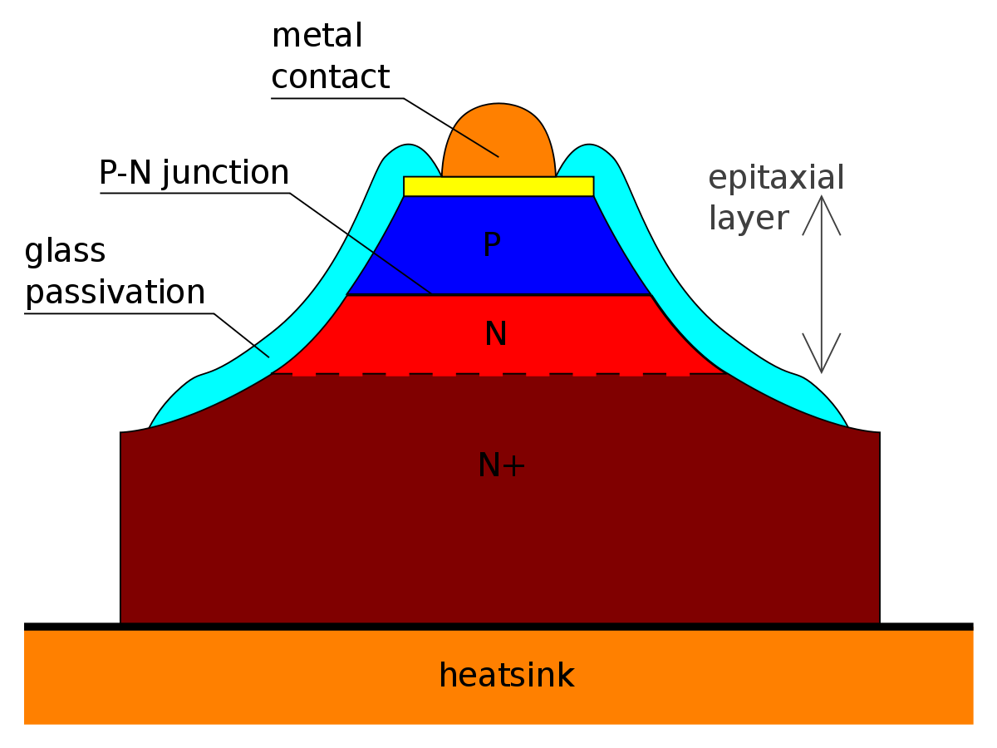
Future Work
Two routes:
Go fully analogue
Remove the need for ADC and microcontrollers
Use variable components to make the system fully analogue
Better Equipment
Use a more expensive sensor and faster microcontroller

Slide 21
Transfer Function for 2D

Slide 22
From 1D to 2D
b
$$F_{m}$$
$$x$$
$$m\ddot{x}$$
$$y$$
$$mg$$
$$F_{1}$$
$$F_{2}$$
$$m\ddot{x}$$
$$m\ddot{y}$$
$$mg$$

Slide 23
Assumptions
b
Y is much larger than X (the magnitude of magnetic force is determined by Y)
Force is along the line from the centre of the ball to the centre of the lower end of the solenoid
Small displacement (the direction of the force does not change)
$$x$$
$$y$$
$$F_{1}$$
$$F_{2}$$
$$m\ddot{x}$$
$$m\ddot{y}$$
$$mg$$

Slide 24
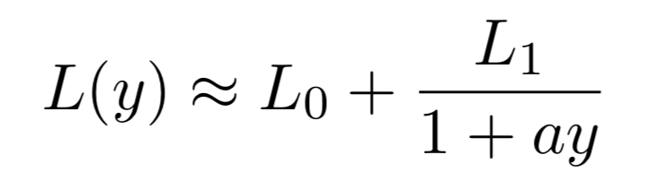
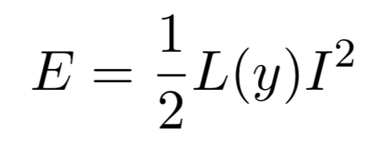
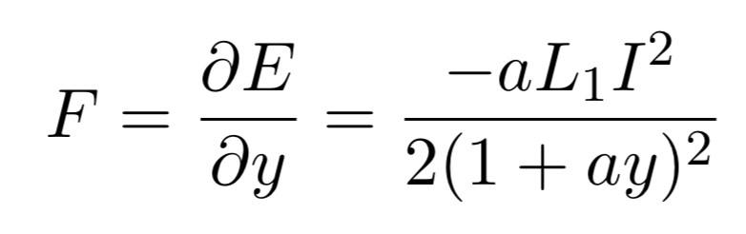
Magnetic Force Calculation
Inductance (Hlebowitsh, 2012)
Coenergy (Roberge, 1975)
Magnetic force (Hlebowitsh, 2012)

Slide 25
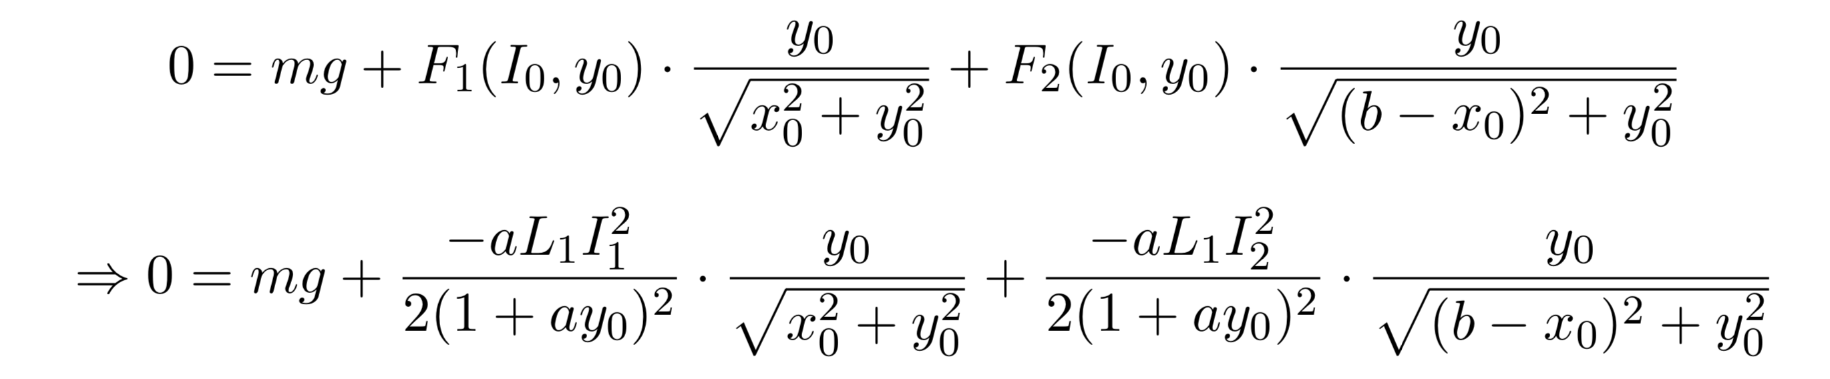
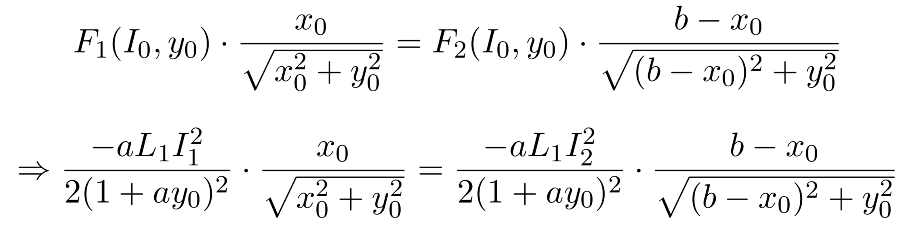
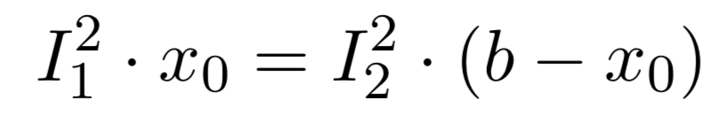
Balance the force
Vertical:
Horizontal:
$y_{0}>>x_{0}$, $\left(b−x_{0}\right) \underset{⇒}{}$

Slide 26
Separate the Movement to Two Steps
b
$$x$$
$$y$$
Horizontal
Vertical

Slide 27
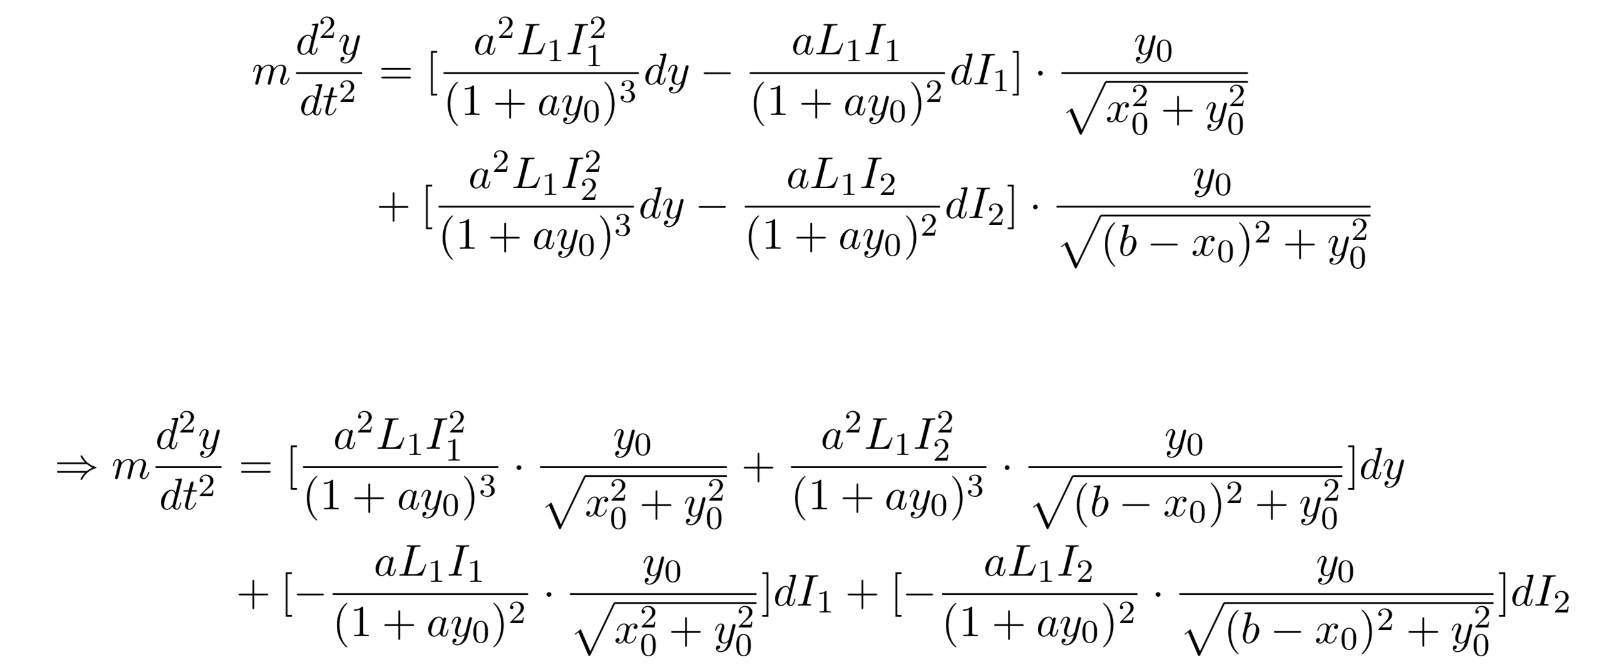
Vertical Movement

Slide 28
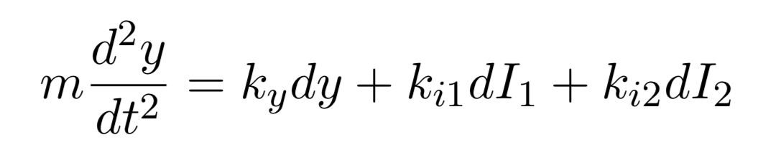
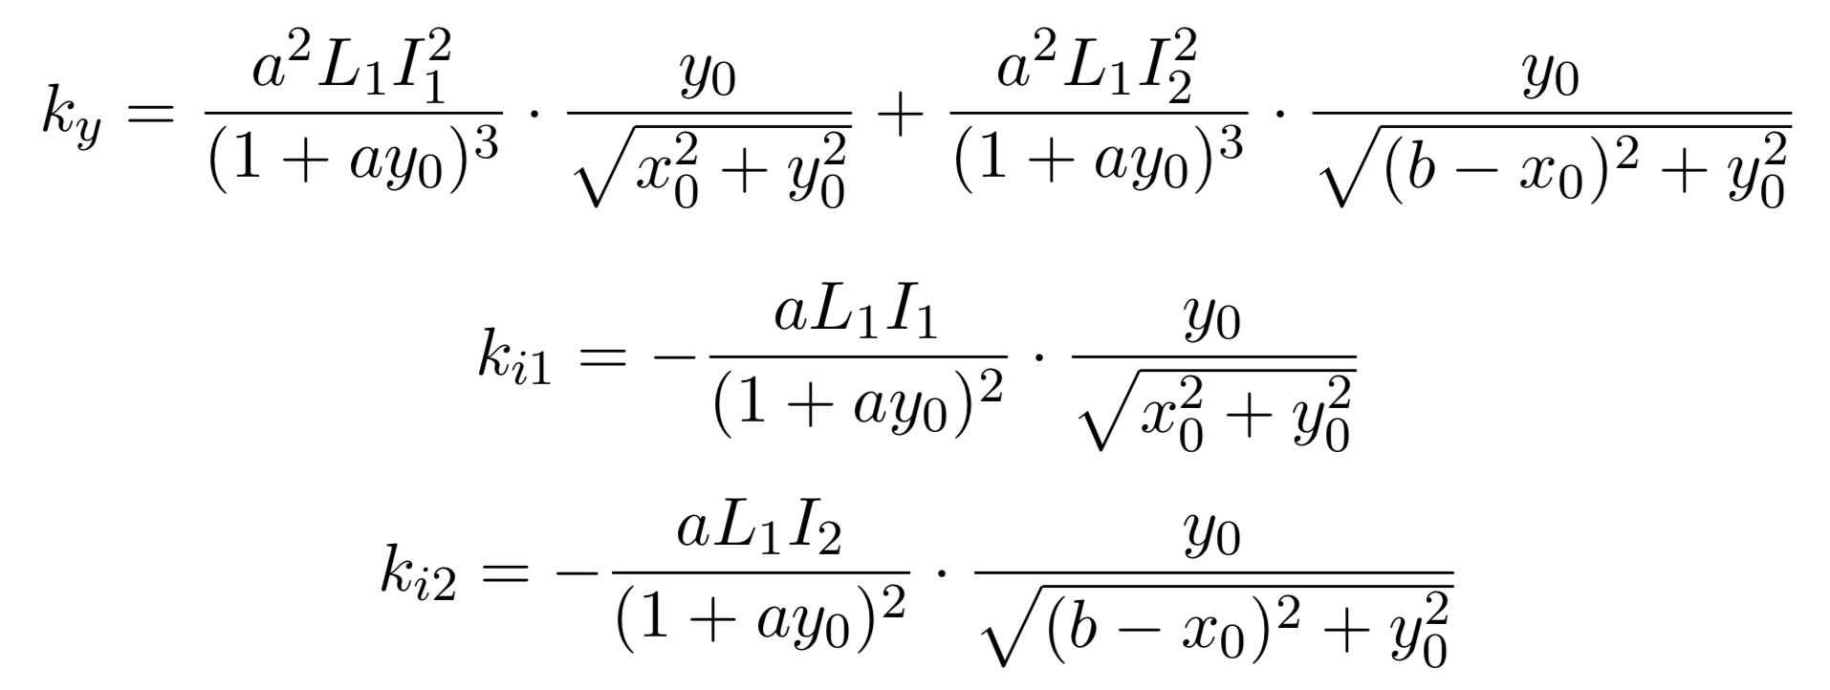
Vertical Movement

Slide 29
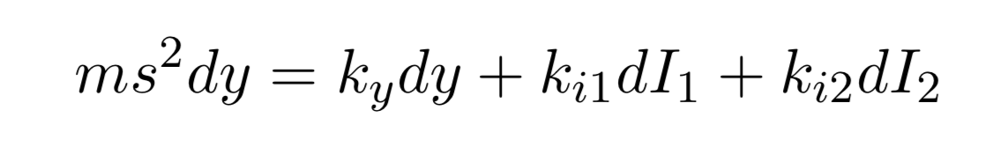
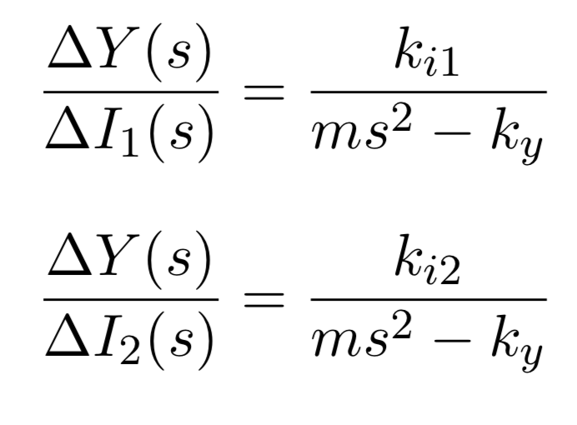
Vertical Movement

Slide 30
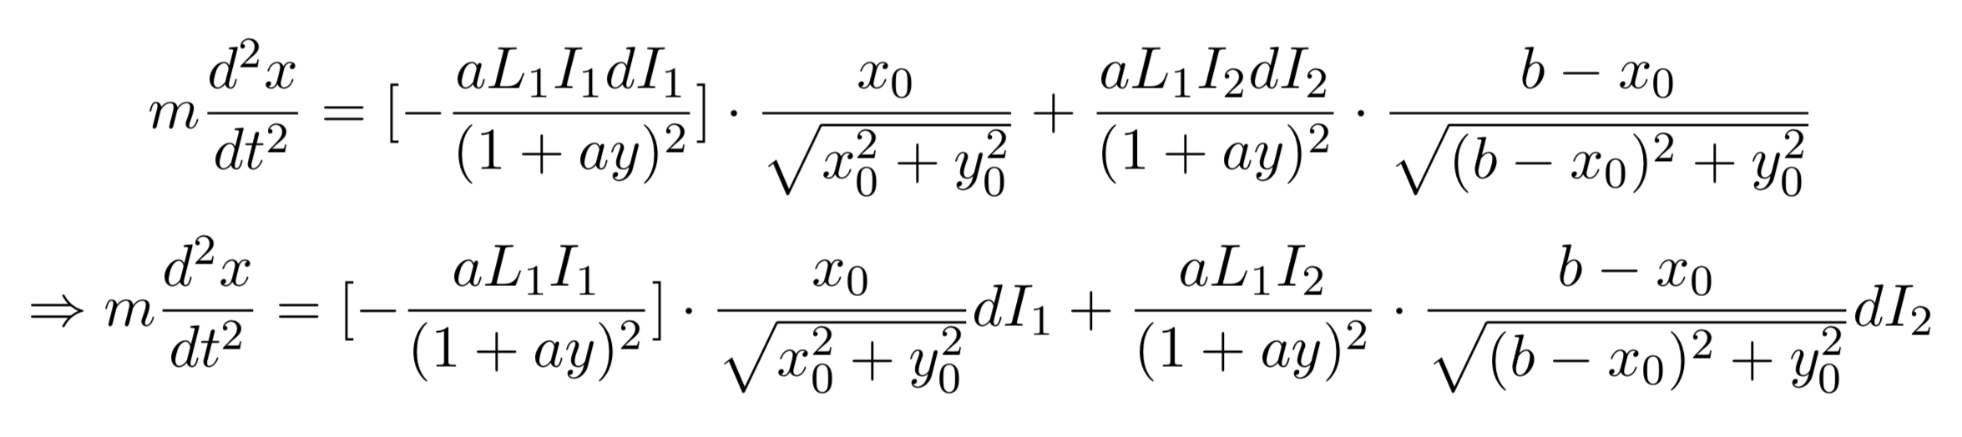
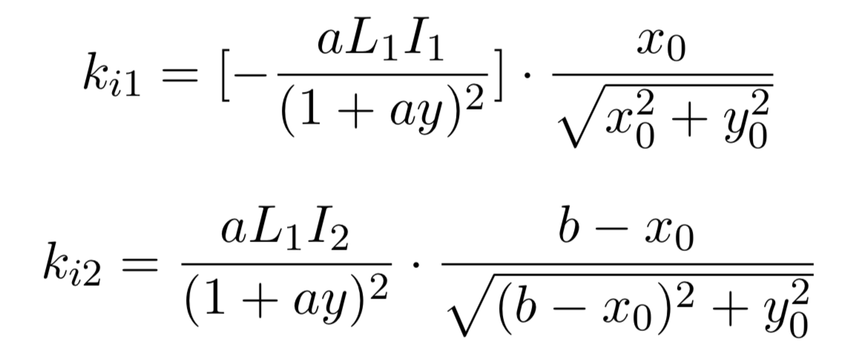
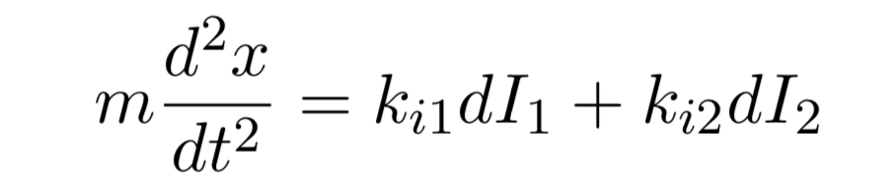
Horizontal Movement

Slide 31
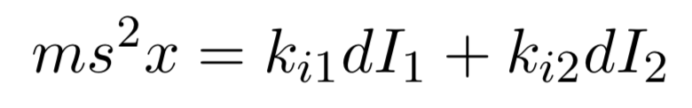
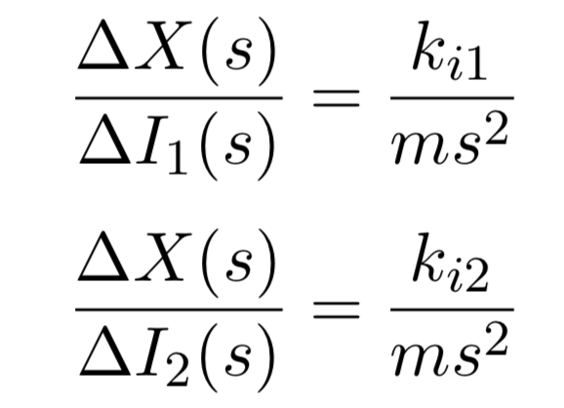
Horizontal Movement

Slide 32
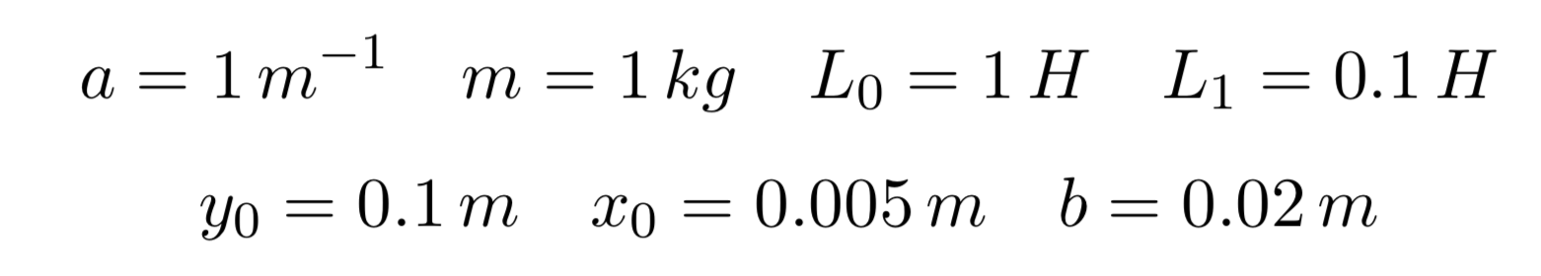
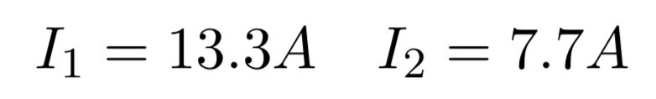
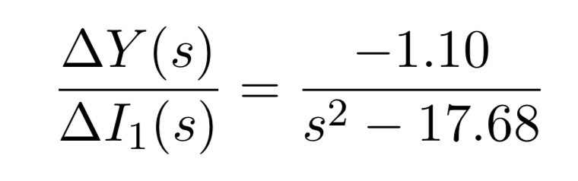
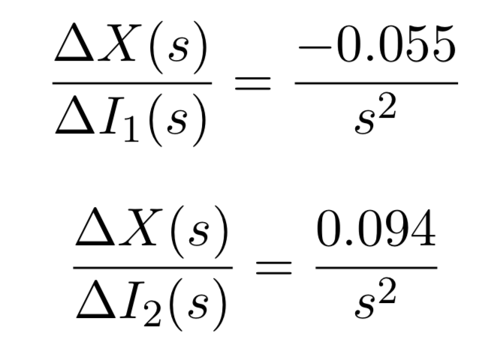
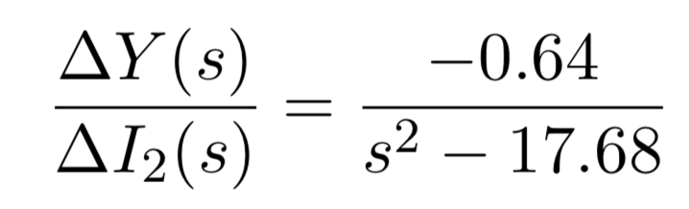
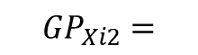
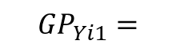
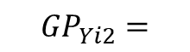
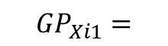
Coefficients Assumptions
$${GP}_{Yi1}=$$
$${GP}_{Xi1}=$$
$${GP}_{Yi2}=$$
$${GP}_{Xi2}=$$

Slide 33
2D Control Strategy

Slide 34
From 1D to 2D: Control Strategy
Linearization is more problematic here due to an increase in nonlinear terms
We need a controller that can respond quickly and subtly so as to not overcompensate. The smaller in magnitude the control, the less it is subject to the effects of nonlinearity.
PID was trialled and shown to be invalid for this application

Slide 35
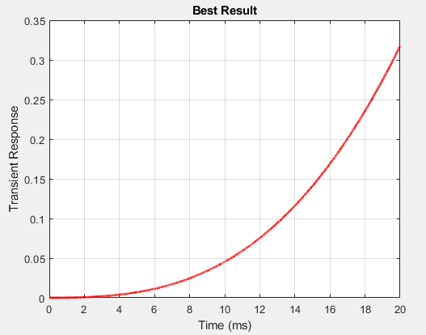
Notes:
Cost of 17.95

Slide 36
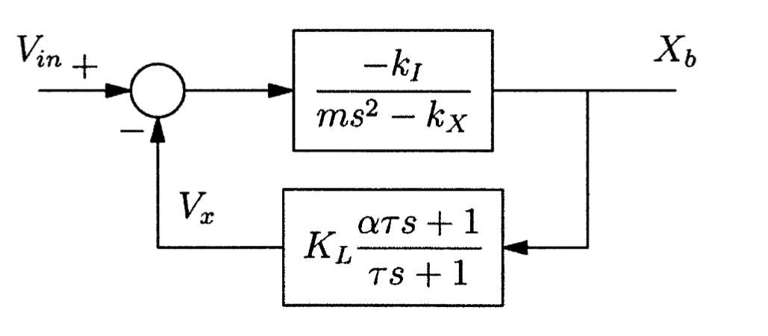
Lead-Lag Compensator
Here shown in the feedback path; can also be implemented as cascade with equal benefits

Slide 37
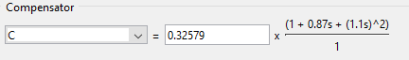
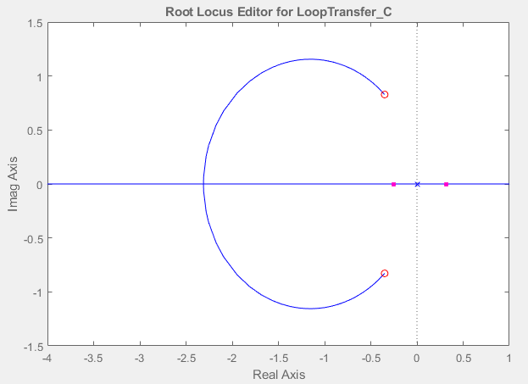
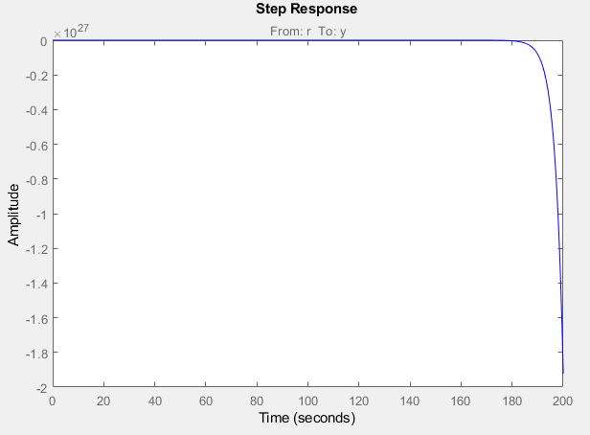
Root Locus Diagram: example for horizontal compensator
Gain
Poles
Zeros
`
Notes:
At K_L=0, the poles of the open-loop poles of the transfer function, G(s)H(s) are the starting point of the root locus plot. The three poles are denoted by an "x" in the Fig rootloc. As K_L increases, the poles begin moving towards the zeros of the open-loop transfer function, G(s)H(s). These are denoted by an ‘o’ in Fig rootloc. Hence, it can be seen from the plot that the lead compensator provides stability to the nonlinear system by moving the extraneous pole into the negative real axis for high gains. Thus, it is a suitable controller. Crucially, as the transfer function for the ‘2D’ system can be described similarly, albeit with different constants, this control method is applicable there as well.

Slide 38




Root Locus Diagram: example for horizontal compensator
Gain
Notes:
At K_L=0, the poles of the open-loop poles of the transfer function, G(s)H(s) are the starting point of the root locus plot. The three poles are denoted by an "x" in the Fig rootloc. As K_L increases, the poles begin moving towards the zeros of the open-loop transfer function, G(s)H(s). These are denoted by an ‘o’ in Fig rootloc. Hence, it can be seen from the plot that the lead compensator provides stability to the nonlinear system by moving the extraneous pole into the negative real axis for high gains. Thus, it is a suitable controller. Crucially, as the transfer function for the ‘2D’ system can be described similarly, albeit with different constants, this control method is applicable there as well.

Slide 39
Lead-Lag compensator
The same method can be used to make a lead compensator for the remaining axes of motion.
Two assumptions are used here:
1- The TFs have been linearized to discorporate the coupled components
2- The values chosen for coil constants, inductances, etc. are not based on any real system. Real values will undoubtedly lead to different control requirements.
→These may invalidate the following proposed control strategies:

Slide 40

‘2D’ Control Strategy with ‘1D’ result
Flaws:
Single current used to control both solenoids
Both x and y TFs are lumped
Superposition can be used by discarding the x effect on y and vice versa. This can only be done by constraining one axis to zero, here, y is chosen.
Their control system is only valid for one y position (dy/di = 0)
Hence, this system provides ‘2D’ control of a ‘1D’ resultant system.
(Hlebowitsh, 2012)
Notes:
Here, they argue that by limiting the vertical displacement to near-zero, they are able to provide stable control of the system in the horizontal direction. Hence, although their control strategy is one of two axes, the effective result is single-axis motion in the horizontal direction. Furthermore, their control model is flawed in its implementation of feedback.
Here, each transfer function is simplified to discard its respective coupled component so that it can instead be implemented via superposition within the control model itself; that is to say, the horizontal transfer function discards the influence of the ball’s vertical position, and vice versa. This is a good method of linearizing the model, but the implementation of feedback is erroneous.
It can be seen from their control diagram that the model sums the effect of each solenoid in the 2-solenoid setup to account for the vertical force on the ball, and subtracts the effect of the second solenoid from the first to account for the horizontal force on the ball. This is accurate in relation to the free-body-diagram. However, in the feedback path, their reliance on a single current to control both solenoids is what causes complications.
They attempt to mitigate the limitations caused by the use of a single current to control both solenoids in their implementation of feedback. Here, it is evident that while the resultant vertical displacement error is added to both solenoids, the horizontal displacement error is added to the first solenoid and subtracted from the second. While this fits with their relative coordinate system, it only works with the assumption that either the horizontal or the vertical displacement can be set to zero and is hence negligible; they have chosen the latter to be set to zero in this case and have hence linearized their model. Hence, superposition can be used to provide ‘2D’ control for the effective result of ‘1D’ displacement.

Slide 41










MIMO strategy: (two inputs – two outputs)
$$I_{1}$$
$$I_{2}$$
Advantages:
Each solenoid controlled by its own current.
Interchangeably set one variable to zero for coupled movements. Hence, movement is done by iterative and small stepwise increments in each direction.
This theoretically provides ‘true’ ‘2D’ control over the system
Implemented programmatically using switch statements
$$x$$
$$y$$
$$F_{1}$$
$$F_{2}$$
$$m\ddot{x}$$
$$m\ddot{y}$$
$$mg$$

Slide 42


Coupled MIMO Description:
Features:
Linearize transfer functions while retaining coupled component effects via hidden feedback loop
The next step is to decouple these components to achieve independent evaluation and control of x and y for iterative process

Slide 43



Decoupled Control:
$T_{Yi2}=$ - $\frac{{GP}_{Yi2}}{{GP}_{Yi1}}$
$T_{Xi1}=$ - $\frac{{GP}_{Xi1}}{{GP}_{Xi2}}$
Process:
Decoupler function nullifies the effect of respectively highlighted coupled elements
Future work: nonlinear decoupler for more accurate system description
Highly nonlinear systems require information on each equilibrium point to operate, hence, a linearized transfer functions may not realistically be used.

Slide 44
Future Plans – 1D Physical System
With a budget, a lot more can be done!
More precise sensor with faster sample rate
Better processing power – higher control loop speed -> more stable control
Removing the inconsistencies and noise
Refine fitness function of Genetic Algorithm
Can be tailored to better fit our system

Slide 45










Future Plans – Multiple Dimensions
$${(X}_{2},Y_{2})$$
$\frac{dX}{di}=0$
Very, very difficult to achieve!
Many regions of instability
Requires a dynamic control system
Plant model will change as a function of x and y for each loop
Requires vast computing power to perform dynamically
Controller must also be a multi-DOF controller for robust control
However, we can approximate the control to achieve similar results
This is the best option going forward
$\frac{dX}{di}=0$
$\frac{dX}{di}=0$
$\frac{dX}{di}=0$
$${(X}_{1},Y_{1})$$
$\frac{dY}{di}=0$
$\frac{dY}{di}=0$
$\frac{dY}{di}=0$
$\frac{dY}{di}=0$
Notes:
This was extremely difficult to achieve even in simulation.
Because there are multiple regions of instability, the PID parameters must change dynamically depending on where the ball is.
And would require enormous computing resources to achieve this (if it is even possible!)
However, we have explored how it is possible to approximate this control to achieve similar results – the horizontal and vertical movement can be controlled at different times, giving a fully controllable system. This is a compromise, as it isn’t quite what we had set out to achieve, but it is an engineering solution to a complex problem that could probably be the subject of several PhDs!!

Slide 46
Thanks for Listening!

